Slide 1

ACES Presents: Civil Service Exams
www.aces300k.org aces300k@gmail.com
1

Slide 2
Overview
DCAS exam website
The OASYS system
Filing for an exam
Next steps
Disclaimer: This presentation is based on my own experiences, and does not reflect the views of DCAS or the NYPD.
www.aces300k.org aces300k@gmail.com
2

Slide 3
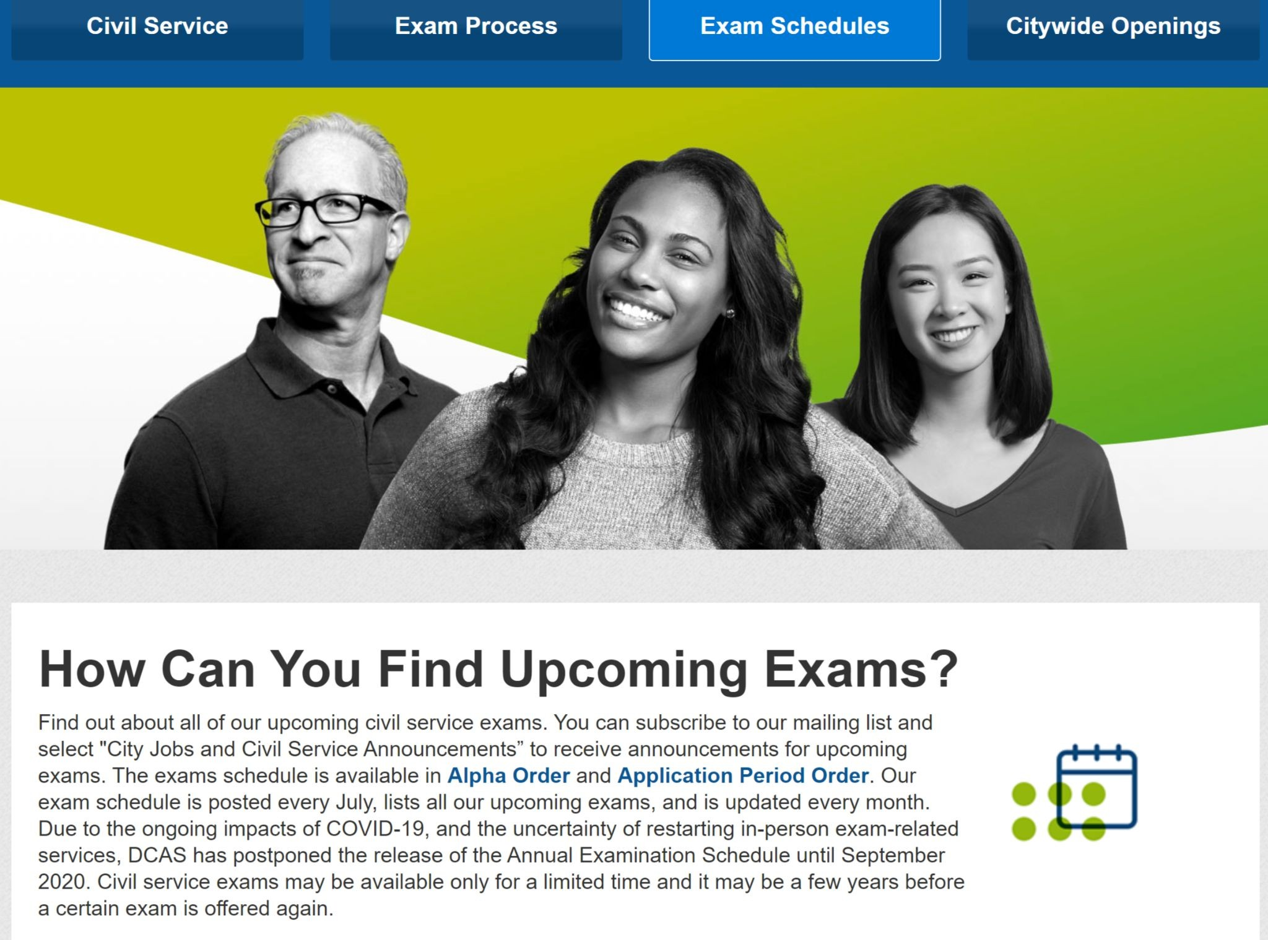
DCAS Exam List Website
Best place to find exams
Three groupings: Open for Anyone, Promotion, and Qualified Incumbent/Provisional
Lists in alpha and application period, with title specs
Filing end date- LAST day to apply/submit
https://www1.nyc.gov/site/dcas/employment/ how-can-you-find-upcoming-exams.page
www.aces300k.org aces300k@gmail.com
4

Slide 4
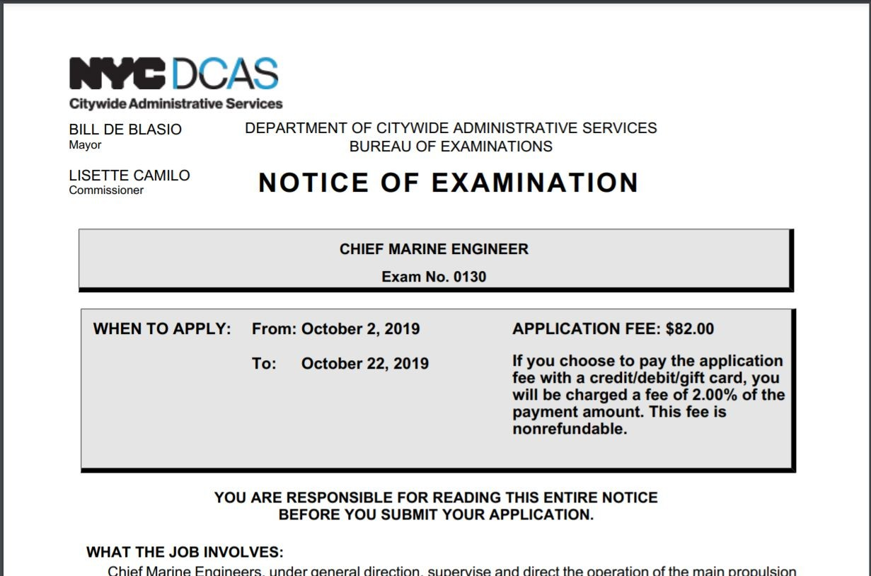
The NOE
Source of truth on exams
Application period, what the job involves, salary, how to qualify, how to apply
The Test
If EEE, minimum quals and above
Example: Say you have 8 yrs exp. 4 yrs + BA/BS = Min+ 4 yrs=85
MA/MS= Min + 8 yrs=100
www.aces300k.org aces300k@gmail.com
-1

Slide 5
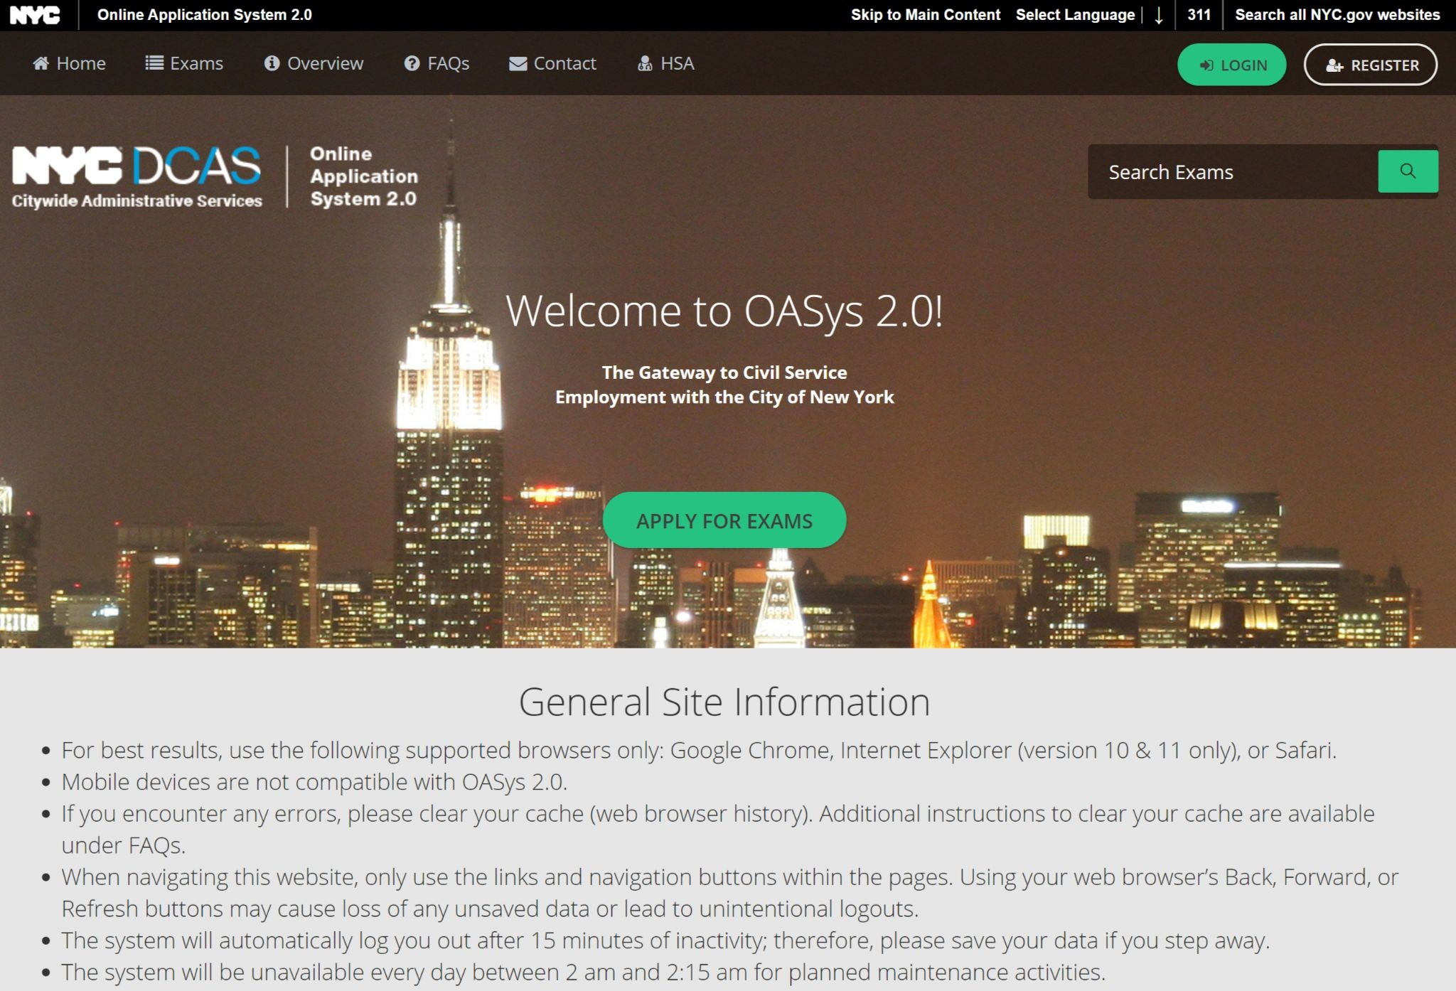
The OASYS System
Exam filing system
Account required, ONE per person
Creation or reset may take a few days
Ensure profile is COMPLETELY filled out
https://a856-exams.nyc.gov/OASysWeb/
www.aces300k.org aces300k@gmail.com

Slide 6
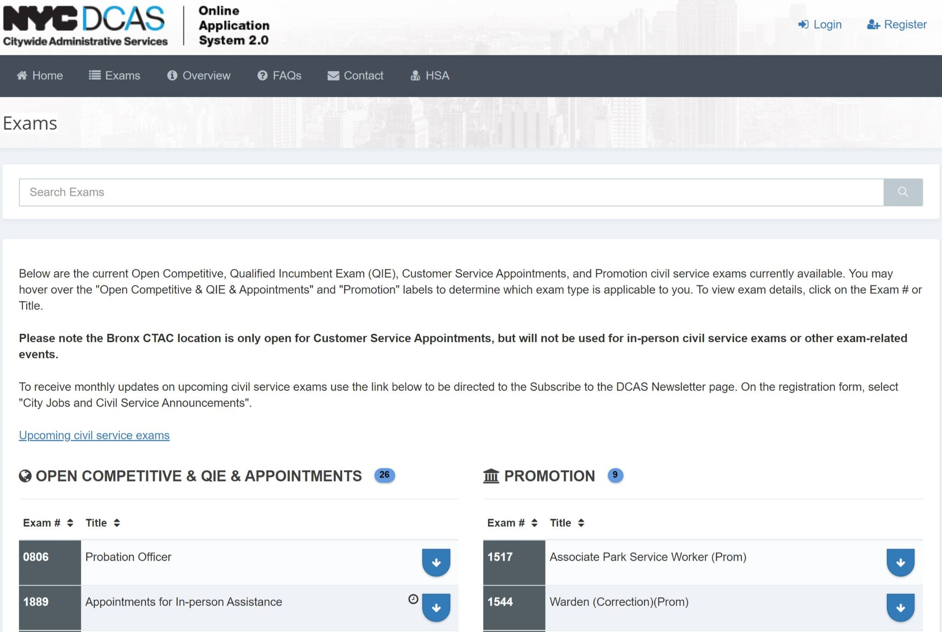
Filing for an Exam-Finding an Exam
Shows the filing date, price, tests, NOE
Click Title to sort
Tip-Keep the exam website open as well
https://a856-exams.nyc.gov/OASysWeb/ Exam/List
www.aces300k.org aces300k@gmail.com

Slide 7
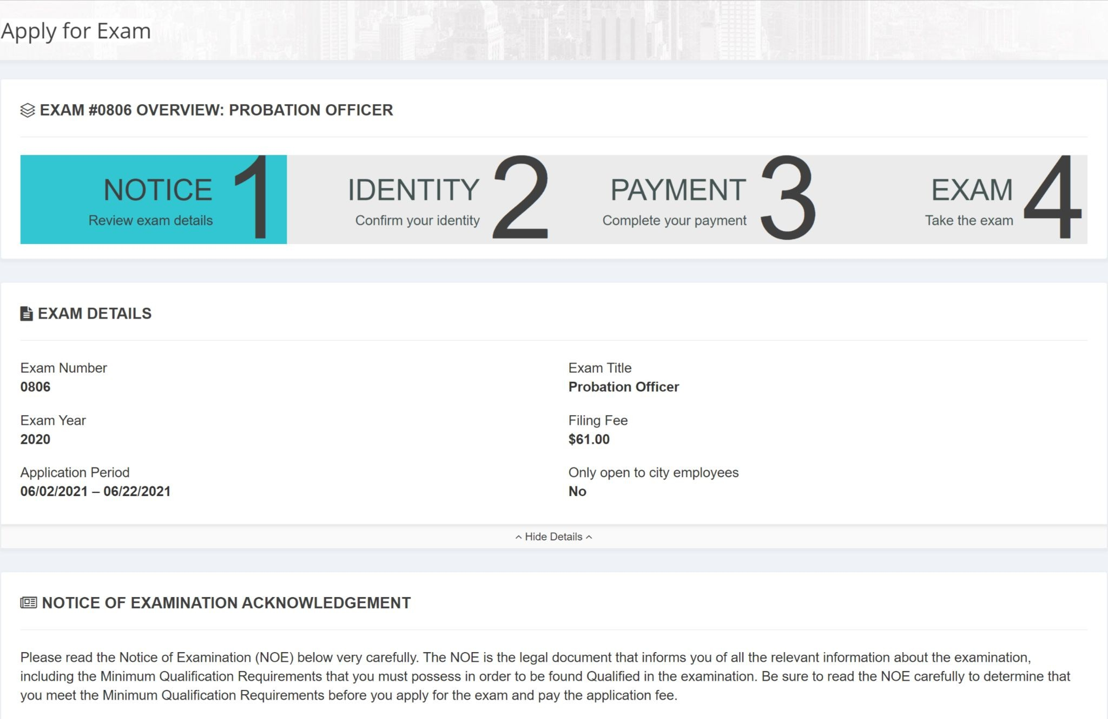
Filing for an Exam-Apply and Pay
Shows current step
Shows you all the information from before
If Education and Experience, you can begin taking immediately after payment
You may be emailed reminders to finish the exam
May receive a preview of tentative score-final submit “locks” it and your answers
www.aces300k.org aces300k@gmail.com

Slide 8
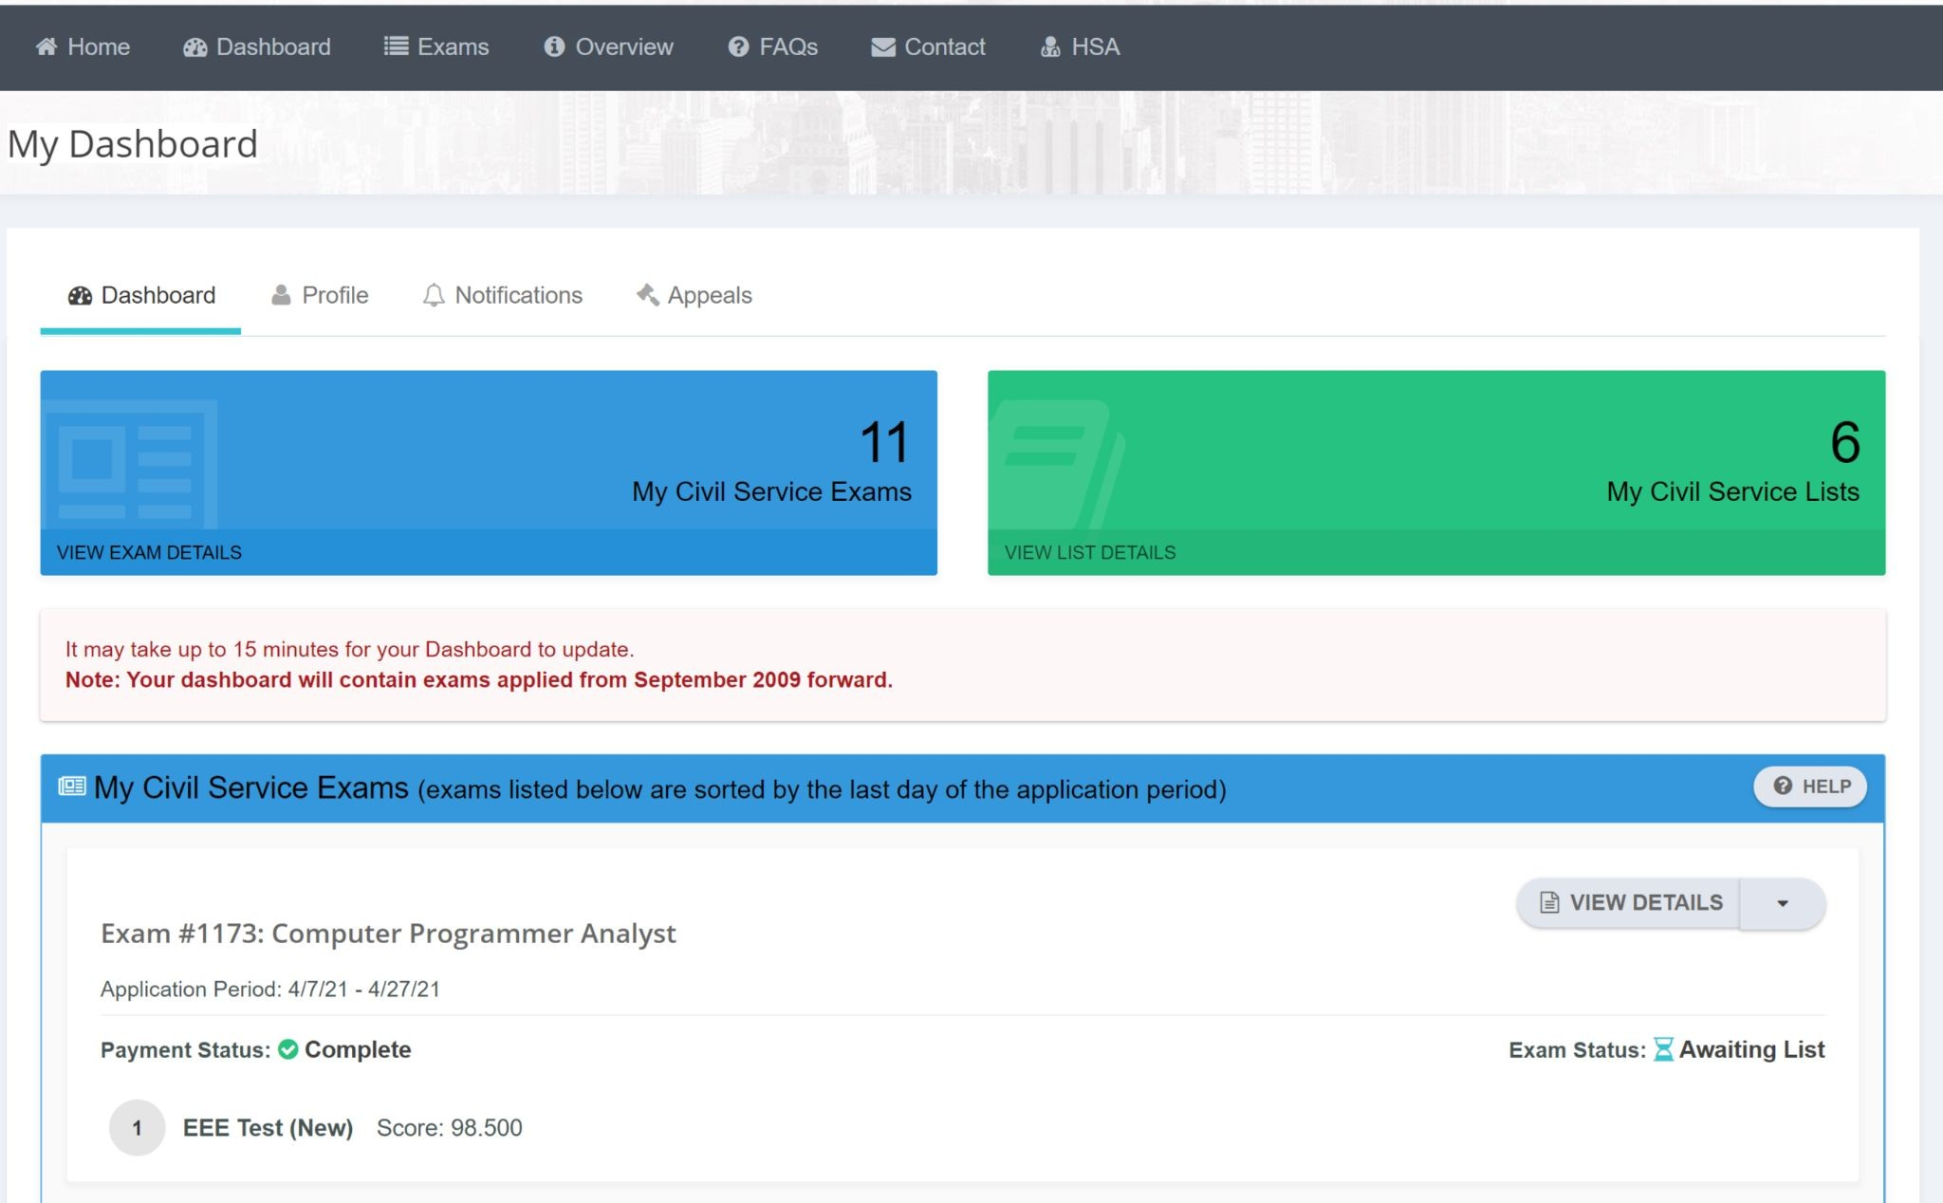
Next steps
Make a list of selective certs and update DCAS as needed- you have until the expiration of the list
Lists may take a year or more to come
out-watch your emails and check your OASYS dashboard!
Contact DCAS for major questions/concerns
When should you file? Now!
Flow: Go to DCAS exams, find exam, login to OASYS, file and pay.
www.aces300k.org aces300k@gmail.com

